Slide 1
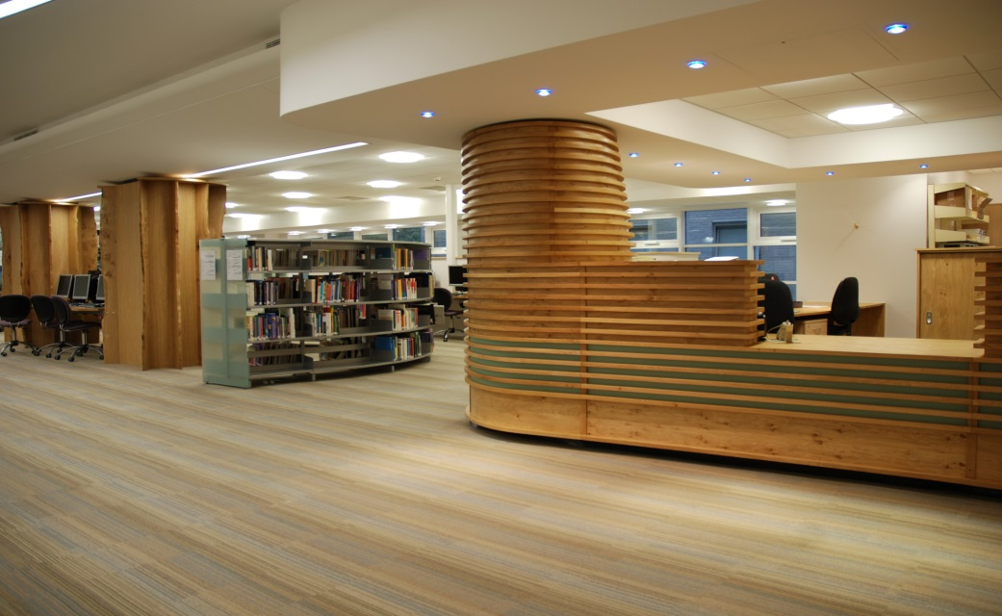
Library Services at Plymouth

Slide 2
Discovery Library
Level 5, Terence Lewis Building
Staffed days: Monday-Friday 0830-1730
24 hour access with your NHS ID badge- please do not use your university ID

Slide 3
Access to collections and services
Borrowing entitlements for up to 8 items.
Use kiosk to left of library exit, issue using your blue SWIMS card
Interlibrary loans
Study spaces, some quiet study

Slide 4
Library IT facilities
24 hour access to PCs throughout the library (NHS login required)
Multi-function device for printing/scanning/photocopying (login with your NHS account details)
Access to WiFi - Eduroam and NHS WiFi

Slide 5
Electronic resources
You need to self-register for an
NHS Athens account
https://openathens.nice.org.uk/

Slide 6
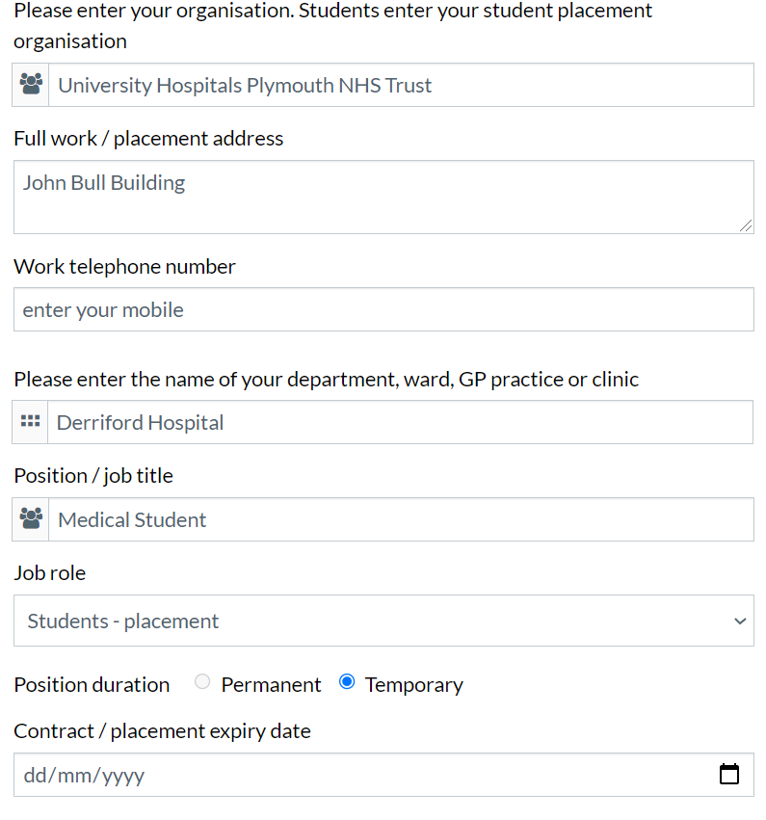
Enter Plymouth in the box and then select
University Hospitals Plymouth NHS Trust
Enter end of course

Slide 7
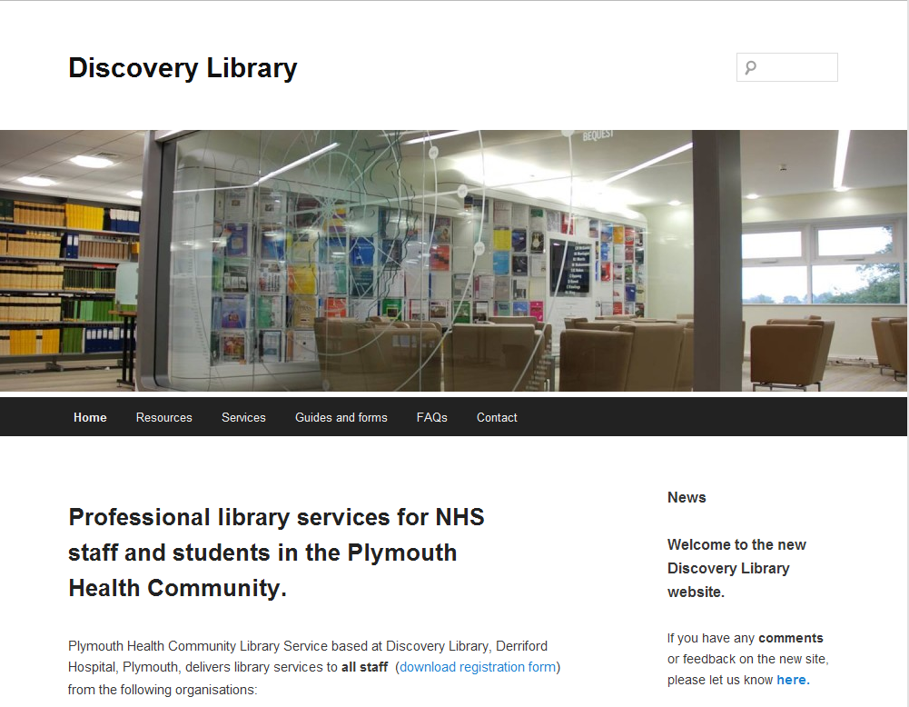
http://discoverylibrary.org/resources

Slide 8
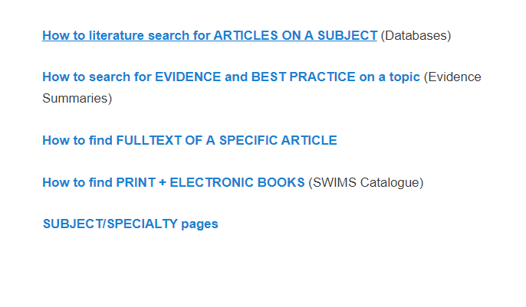
http://discoverylibrary.org/resources
Select section based on type of information you are looking for

Slide 9
Databases
https://discoverylibrary.org/resources/#databases
How to literature search for
ARTICLES ON A SUBJECT

Slide 10
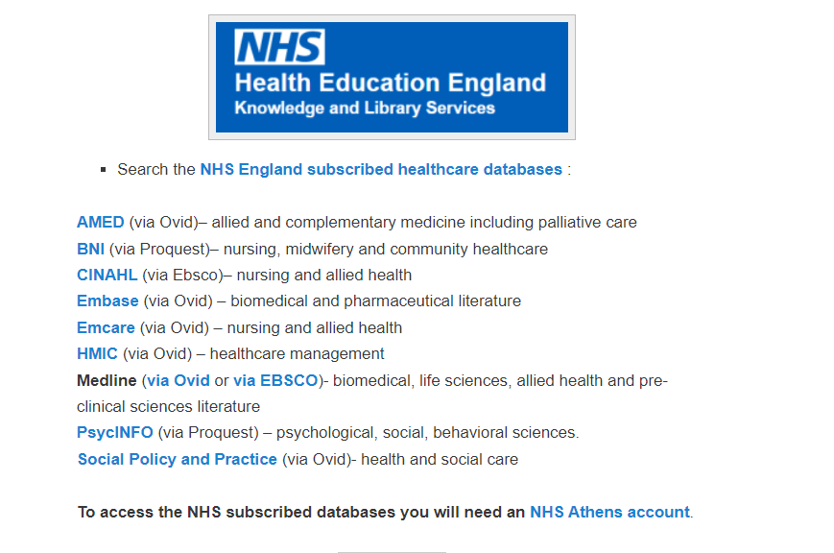
Access bibliographic databases
to search for references across a topic

Slide 11
Evidence Summaries
https://discoverylibrary.org/resources/#ebp
How to find EVIDENCE and
BEST PRACTICE on a topic

Slide 12





A range of evidence-based resources available to help inform patient care or support your study

Slide 13
https://discoverylibrary.org/resources/#journals
How to find
FULLTEXT OF A SPECIFIC ARTICLE

Slide 14
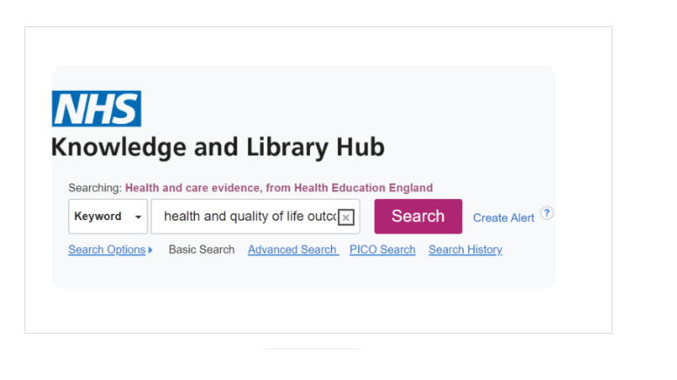
Access NHS Library and Knowledge Hub
to locate fulltext of specific article
(or order copy where we don’t have access)
-searching by article title

Slide 15
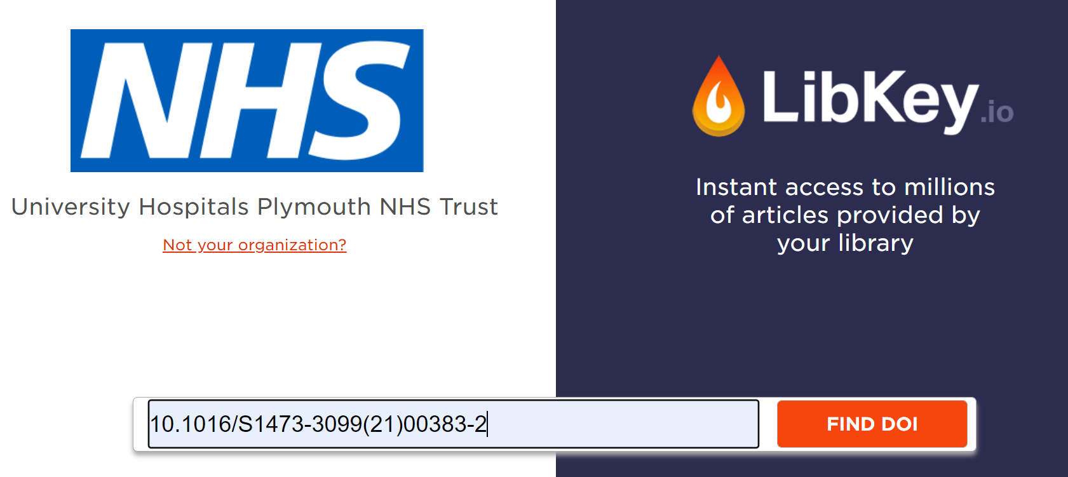
Access LibKey
to locate fulltext of specific article
(or order copy where we don’t have access)
-searching by Digital Object Identifier DOI or PubMed ID PMID

Slide 16
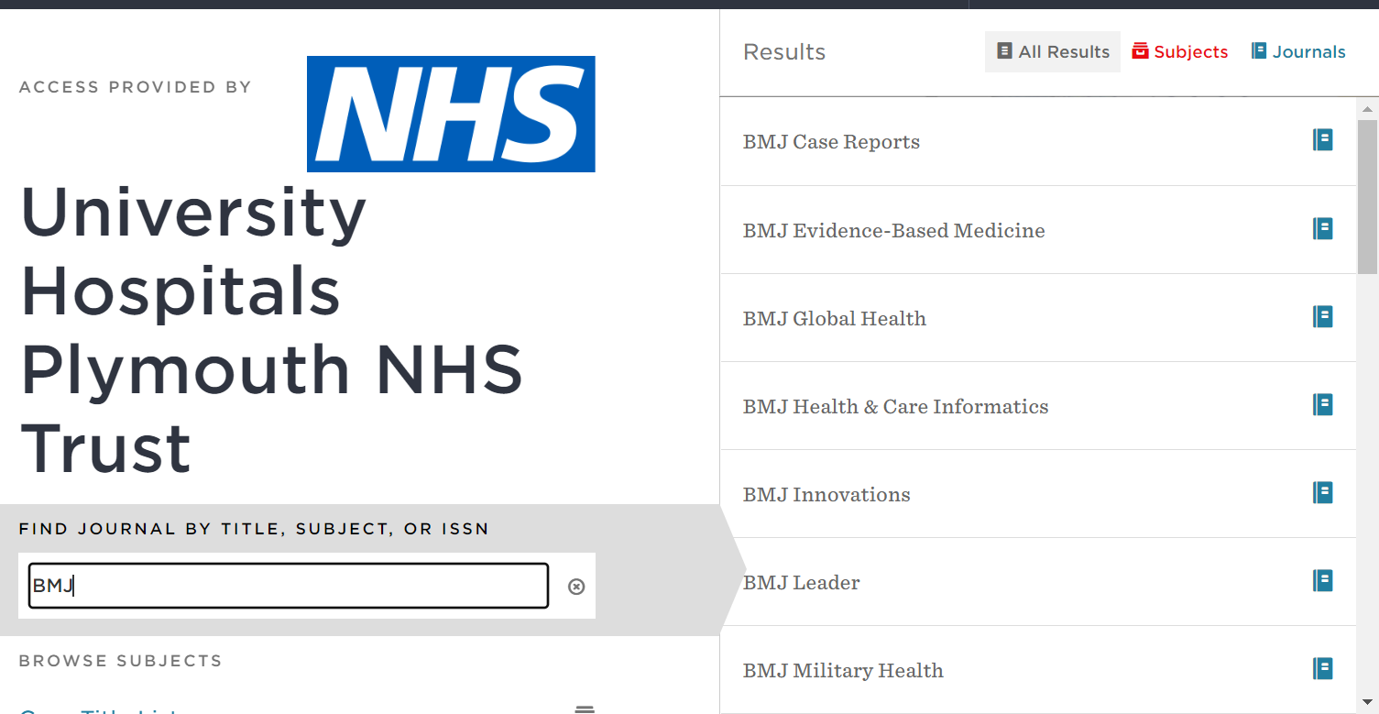
Access Browzine
to locate fulltext of specific article
(or order copy where we don’t have access)
-browsing by journal title

Slide 17
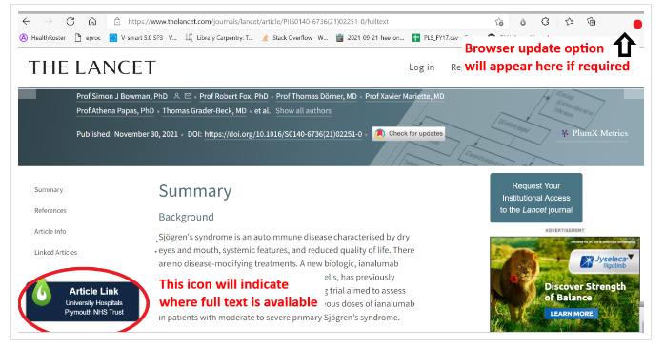
Access LibKey Nomad
to locate fulltext of specific article
(or order copy where we don’t have access)
-browser extension (works automatically on UHP machines via Microsoft Edge)

Slide 18
https://discoverylibrary.org/resources/#books
How to find
PRINT AND ELECTRONIC BOOKS

Slide 19
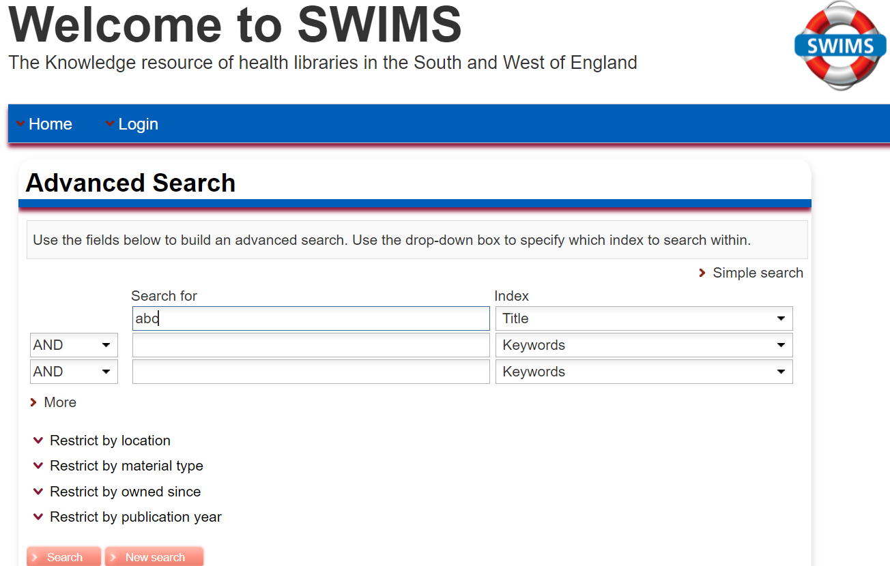
Access SWIMS library catalogue
to
Check print and electronic book stock
Renew print loans

Slide 20




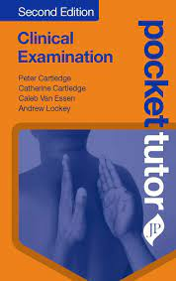



Student ebooks
https://discoverylibrary.org/studentebooks/

Slide 21
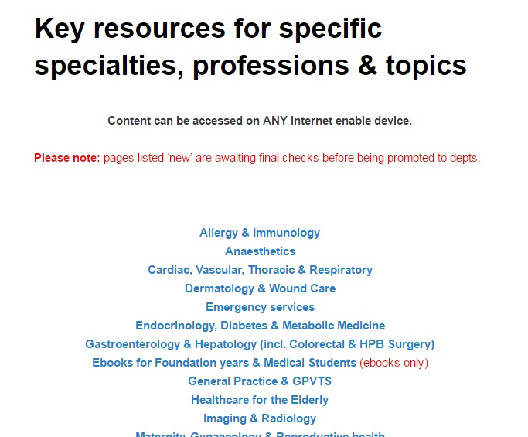
Subject specific pages http://discoverylibrary.org/subjects

Slide 22
Support available
Email library.mailbox@nhs.net to request
  1-to-1 or group training on resources
  Literature search assistance

Slide 23
Contact:
library.mailbox@nhs.net
Tel: 01752 439111
Internal: 39111

