Slide 1
Searching the NHS library resources
discoverylibrary.org
library.mailbox@nhs.net

Slide 2
Where should I look?

Slide 3
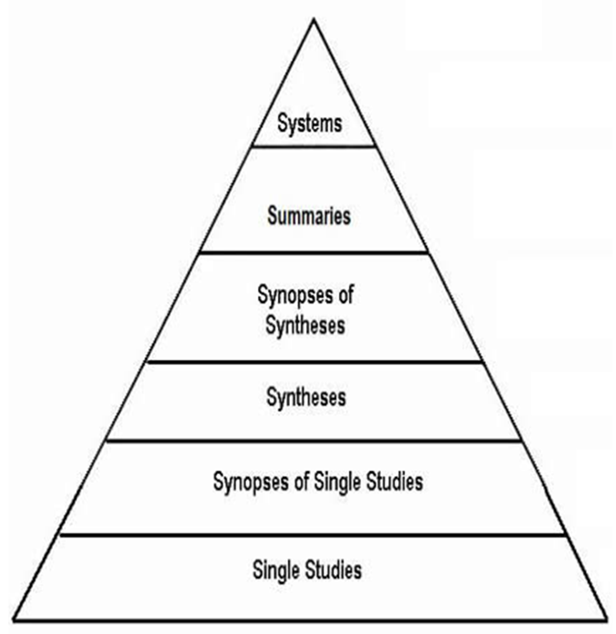
What do you need resources for? | Useful places to search
An overview of a topic for a course | Swims book catalogue, Trip, BMJ Best Practice, CKS
Updating current practice | Bibliographic databases
Overview of good practice at the point of care | BMJ Best Practice, CKS, Trip, Cochrane
An academic essay comparing different articles on a subject | Bibliographic databases
Creating a guideline | Trip, Cochrane, bibliographic databases
New research article for discussion at a team meeting / journal club | Library hub, bibliographic databases
Systematic review | Bibliographic databases, Cochrane, trial registers, relevant national bodies
BMJ Best Practice, Clinical Knowledge Summaries (CKS), DynaMed
Trip
Cochrane
Bibliographic databases

Slide 4
Databases
CINAHL (via Ebsco)– nursing and allied health
Embase (via Ovid) – biomedical and pharmaceutical literature
Emcare (via Ovid) – nursing and allied health
HMIC (via Ovid) – healthcare management
Medline (via Ovid or via EBSCO)- biomedical, life sciences, allied health and pre-clinical sciences literature
Social Policy and Practice (via Ovid)- health and social care

Slide 5
Searching the bibliographic databases

Slide 6
Principles of searching

Slide 7
What is a literature search?
An organised search to find information relevant to your question
To do a good literature search you will need to:
  Define your question
  Decide where to look for information
  Develop a search strategy
  Apply your search strategy to your chosen resources
  Refine your strategy
  Save your results
  Document your search process
Searching is a craft – it takes time to do it well!

Slide 8
Defining your question
Having a clearly defined question will help you to structure your search
It will also make it easier to decide which of your search results you want to keep
You can use a recognised model to help you define your question and identify searchable elements

Slide 9
Search models
PICO
SPICE
Patient/population | People with gestational diabetes
Intervention | Diet and exercise
Comparison (optional) | Insulin
Outcome | Healthy pregnancy and birth
Setting | In a lunch club for seniors
Perspectives | From the perspective of participants
Intervention | How do in situ health checks
Comparison | Compare with practice-based appointments
Evaluation | In engagement with the annual health check programme

Slide 10
Now think about alternative words that could be useful – synonyms, acronyms, American spellings/terms, chemical/generic or trade names, single word or phrase/hyphenated etc.
Patient/population | patients in Intensive Care | ICU, intensive care, critical care
Intervention | pharmacological | antipsychotics, valproic acid
Comparison | nonpharmacological | family centred care, night time ear plugs, family visiting
Outcome | delirium | hallucinations, psychoses

Slide 11
General search concepts
Notes:
The following general principles apply to most searching. Most databases offer some flavour of these functions but they may be labelled slightly differently from one resource to the next.

Slide 12
Textwords, keywords and subject headings – what’s the difference?
Textwords refers to any word(s) you choose to search for in a field such as the title or abstract. They can be freely chosen but will only return results that match exactly. A textword search for “adolescent” will not retrieve articles which only refer to “teenager” instead.
Keywords are usually assigned by authors. A combination of keywords will give the reader a sense of the whole paper. But keywords are very subjective and different authors my use different keywords for the same concept
Subject headings are often applied to records in commercial databases. They are taken from a controlled vocabulary, or a taxonomy. By using terms from a defined list, subject headings can overcome the variation between authors in choice of terminology. For example, in PsycInfo searching for Psychosis as a subject heading will retrieve schizophrenia, postpartum psychosis and so on

Slide 13
Apply your search terms
Apply them one at a time
Search for relevant subject headings
  Use the hierarchy of subject headings to navigate to the most suitable term
Search for textwords as well
  You can make textwords more flexible by using wildcards, for example using * to replace different word endings
  child* will retrieve child, children, childrens, childhood etc.
  You can also make textword searching more specific by using phrases “ “ “community care” will retrieve fewer but more relevant results than community care
  If phrase searching isn’t appropriate, each database offers a way of searching two words near to each other in any order
Notes:
Ebsco – Near Operator (N) e.g. community N5 care would find results with 5 or fewer words between community and care, in any order
Ovid – Adjacency Operator (ADJ) e.g. community ADJ5 care would find results with 5 or fewer words between community and care, in any order
Proquest – Near Operator (NEAR or N/) e.g. community N/5 care would find results with 5 or fewer words between community and care, in any order

Slide 14
Combining sets
Each line of a search is usually a stand-alone search. To bring these together into a complex search that will better answer your question, you will need to combine the sets.
Do this with Boolean operators:
AND – gives you the intersection of two sets.
OR – gives the combined inclusion of two sets. As a prompt that you get bigger numbers when you us OR, remember that “OR means MORE”
NOT – gives the remainder of one set when the other is removed. NOT is not used frequently but can be a powerful tool for removing records which aren’t relevant to your search
Notes:
Each line of a search is usually a stand-alone search. To bring these together into a complex search that will better answer your question, you will need to combine the sets.
Do this with Boolean operators:
AND – gives you the intersection of two sets.
OR – gives the combined inclusion of two sets. As a prompt that you get bigger numbers when you us OR, remember that “OR means MORE”
NOT – gives the remainder of one set when the other is removed. NOT is not used frequently but can be used for removing records which aren’t relevant to your search (but be careful, it can also accidentally remove articles that might be useful)

Slide 15
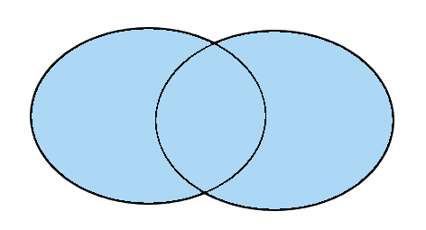

Combining sets
metformin OR insulin returns all results that make reference either to metformin or insulin or both.
metformin
insulin
diabetes AND diet returns all results that make reference to both diabetes and diet.
diabetes
diet
Notes:
Each line of a search is usually a stand-alone search. To bring these together into a complex search that will better answer your question, you will need to combine the sets.
Do this with Boolean operators:
AND – gives you the intersection of two sets.
OR – gives the combined inclusion of two sets. As a prompt that you get bigger numbers when you us OR, remember that “OR means MORE”
NOT – gives the remainder of one set when the other is removed. NOT is not used frequently but can be used for removing records which aren’t relevant to your search (but be careful, it can also accidentally remove articles that might be useful)

Slide 16
Refining your search – using limits
Most databases offer a range of options for limiting your search results.
  Publication date
  Language of the article
  Population age range (infant, child, adult)
  Publication type (RCT, review etc)
Notes:
Hint – “country of publication” isn’t always helpful. To find research relating to the UK, use a search hedge.
Hint – searching for diversity or ethnicity? Use a search hedge

Slide 17
Reviewing and saving your results
Most platforms allow you to mark your favourite items, adding them to a clipboard or folder as you go through sets of results
You will then be able to export or save your results by:
  Emailing them to yourself
  Opening or saving them in a document format (eg Word, Excel or PDF)
  Saving them to a reference management package
A reference management tool is helpful especially if you use multiple databases, need to cite references in your own documents or manage several projects. Reference management tools include:
  Subscription: EndNote, RefWorks
  Free to use: Mendeley, Zotero

Slide 18
Saving and documenting your search history
It is good practice to keep a record of what you searched, and when
  This saves time if you have a similar enquiry in future
  It also shows the steps you took to find your information
  Other people may want to reproduce your search
Most platforms allow you to save your search history as a long-term record
You may also want to use your saved searches to send you alerts when new material is added
If you are conducting a systematic review, familiarise yourself with the PRISMA Statement

Slide 19
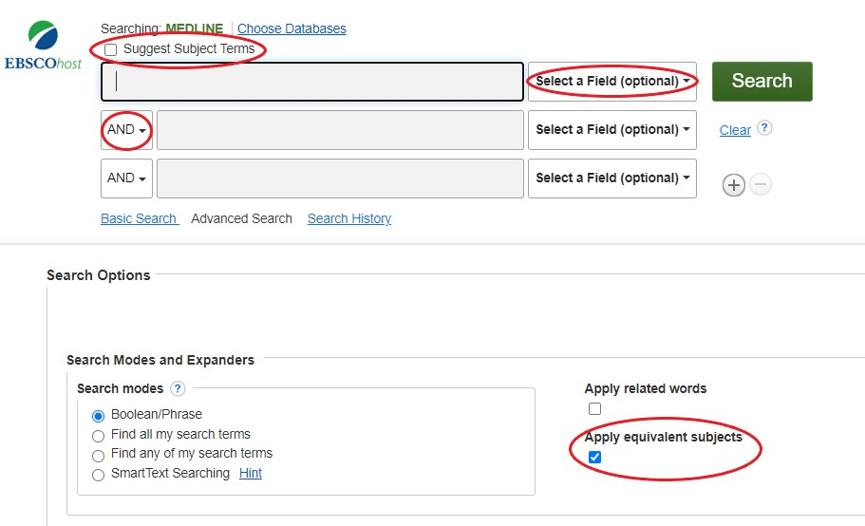
Ebsco

Slide 20
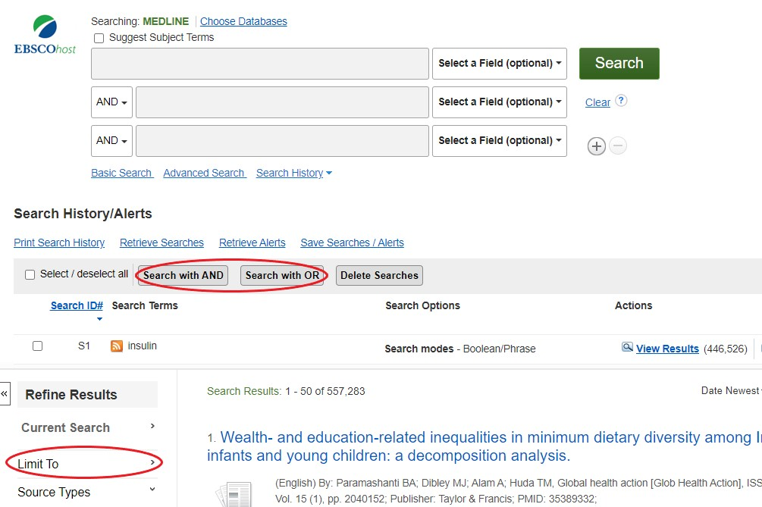
Ebsco

Slide 21
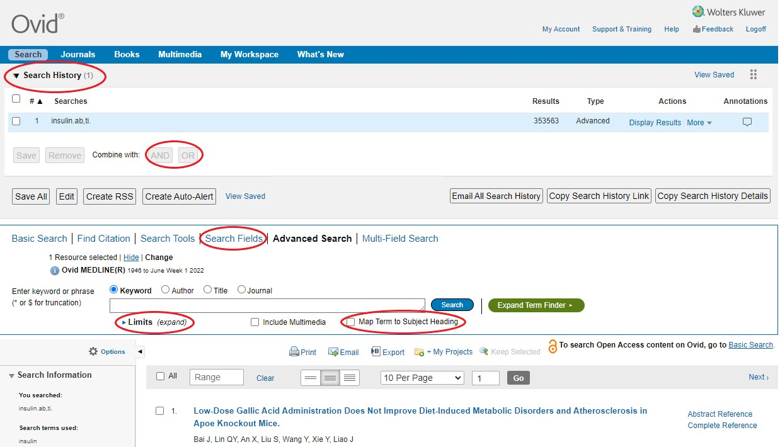
Ovid

Slide 22
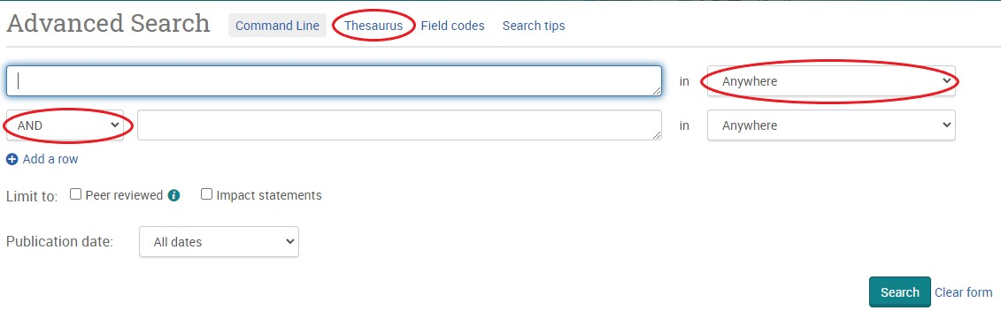
Proquest

Slide 23
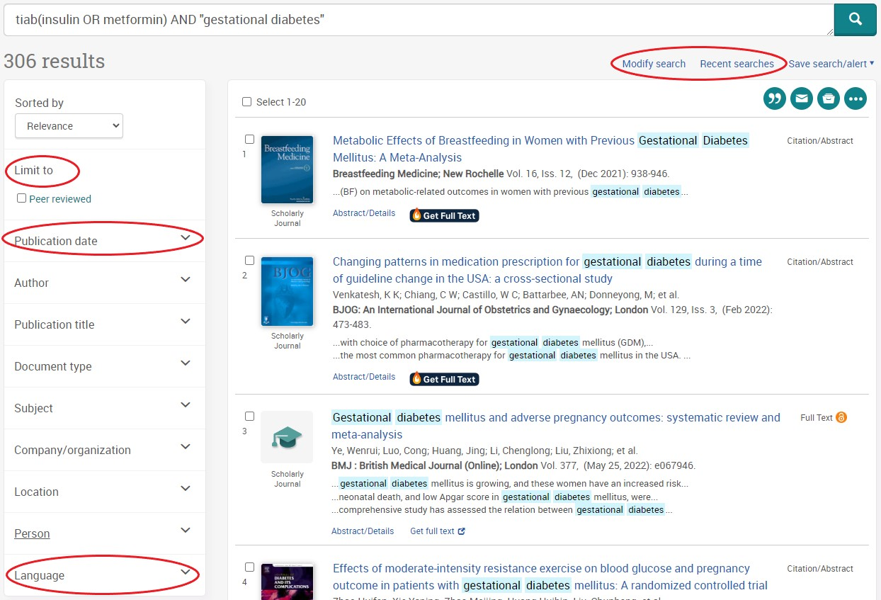
Proquest

